Slide 1


Slide 2

MÓDULO #6
Data Visualization
Power BI
Camila Ribeiro

Slide 3



Camila Ribeiro
Consultora de Data & AI
camilamcn
Camila.Ribeiro@microsoft.com

Slide 4
Agenda
Power BI Overview
Power BI Desktop Developing a Dashboard
Visualizações
Material para estudo

Slide 5
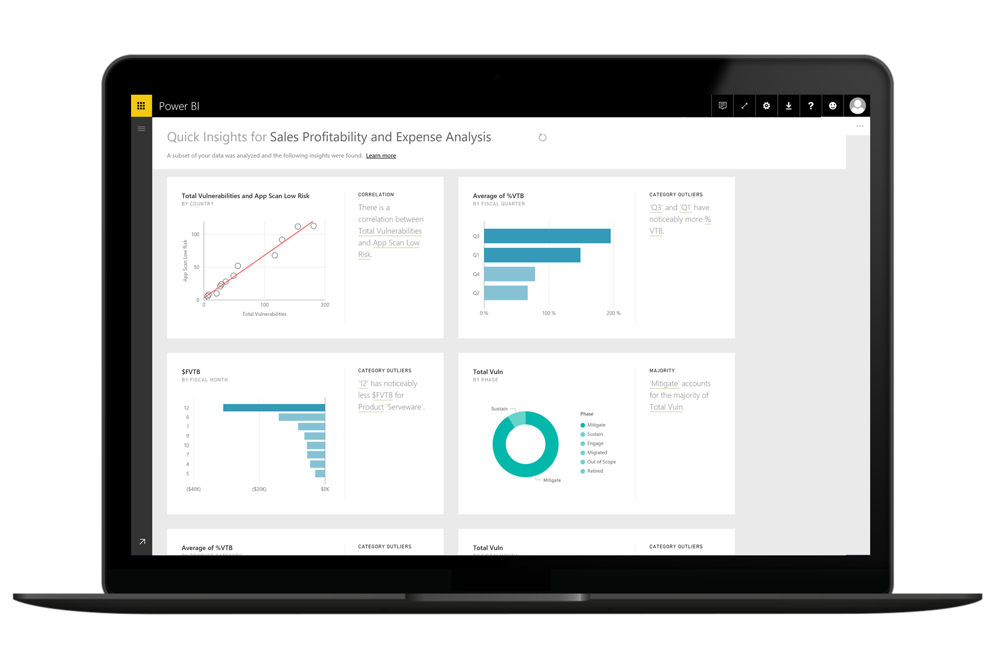
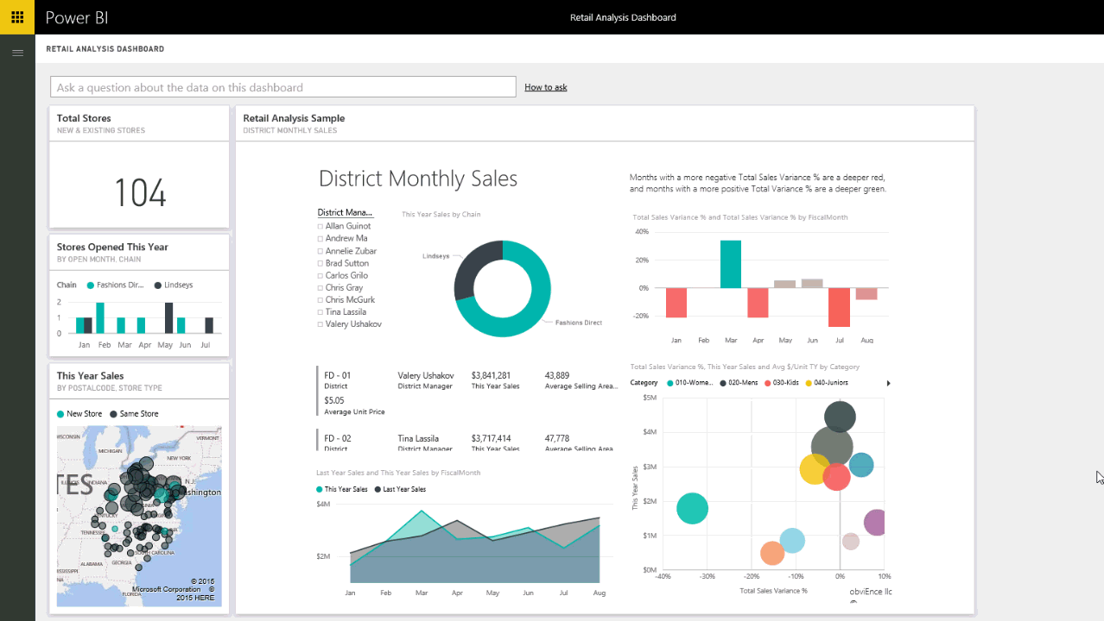

Power BI

Slide 6

Conhecendo o Power BI

Slide 7
Acessar
Compartilhar
Limpar
Visualizar
Combinar
Explorar
Notes:
If we want to deliver on this vision then we need to start with the end user needs. It turns out that end users needs 6 things:
Access to data: the ability to easily connect to data that lives in different systems and locations
Clean data: The data does not usually come in the form that end users needs and a lot of time there are errors in the data. End users need an easy way to clean the data and model it in a format that is optimized for their reporting.
Mash-up data: Users need to combine data from multiple sources in order to produce the reports that they need. They need an easy way to connect data from multiple data sources and mash it up together
Explore: Then once they do all of this users need an easy way to explore that data, drill-down, slice and dice ,and find the insights and hidden trends in the data.
Visualize: Once they identify the insights they need to be able to Visualize that data so that is easy to share those insights with other users. As we usually say a picture is worth a 1000 words.
Share: Finally, they need an easy way to share these insights with others users
Once the data is shared with others, the same process starts again for that user, where he/she might want to add sources, look at the data form a different perspective, ask new or different questions.

Slide 8
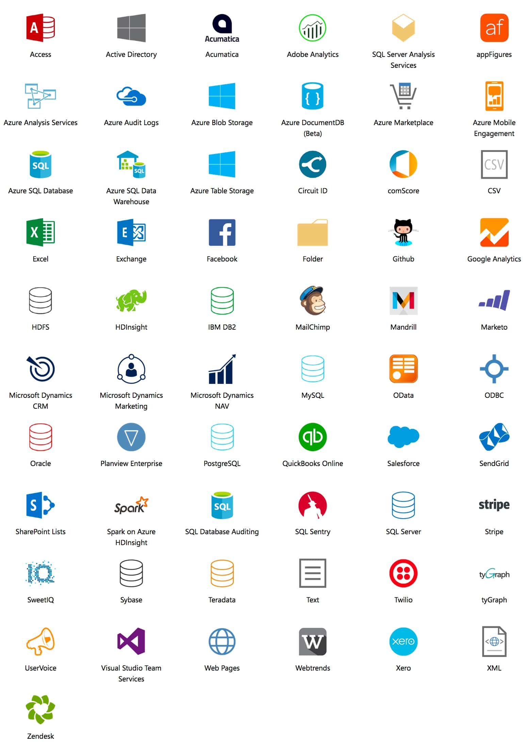
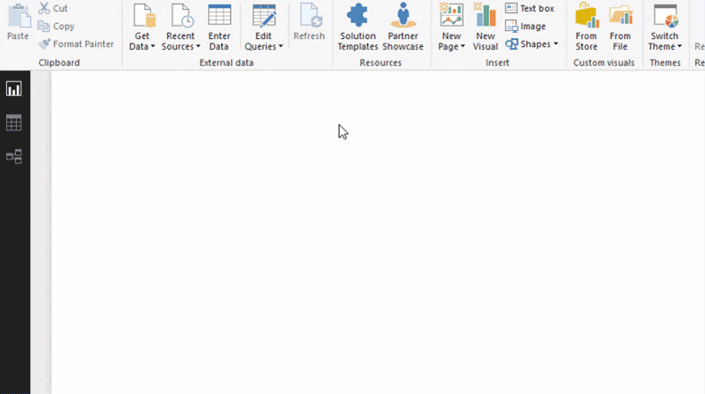
Acessar

Slide 9
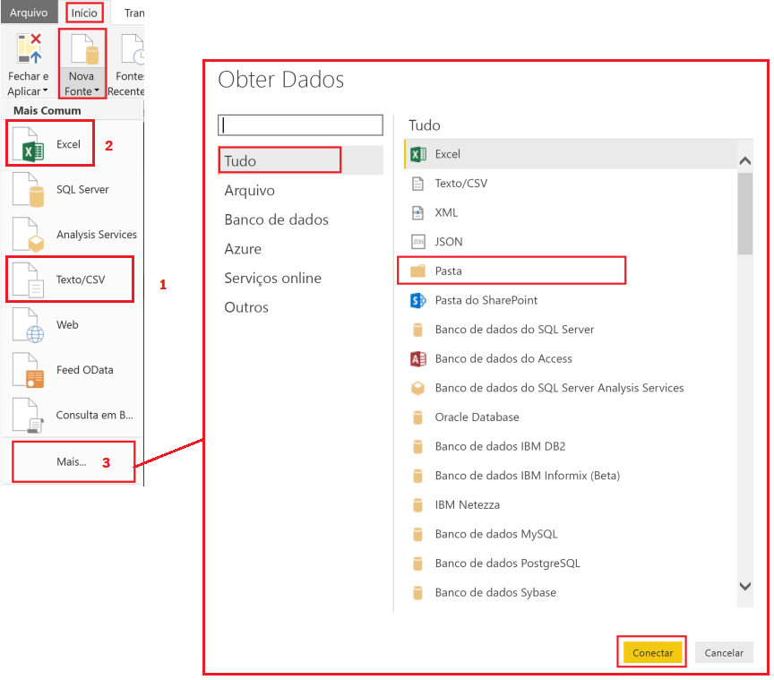
Vamos praticar?
Adicione a fonte de dados CSV: sales.csv
Inclua nova fonte de dados XLS: bi_dimensions.xlsx
Combinar os dados de diversos arquivos do diretório InternationalSales em uma única consulta.

Slide 10
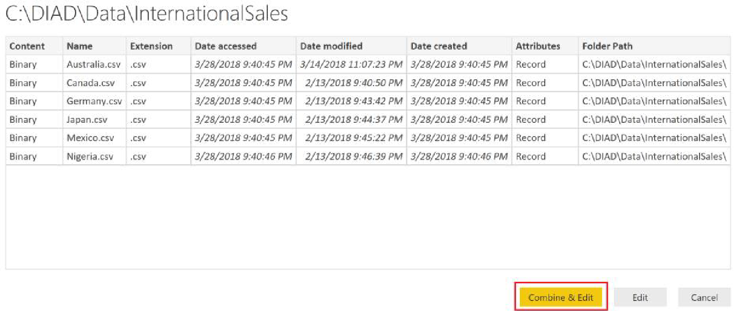
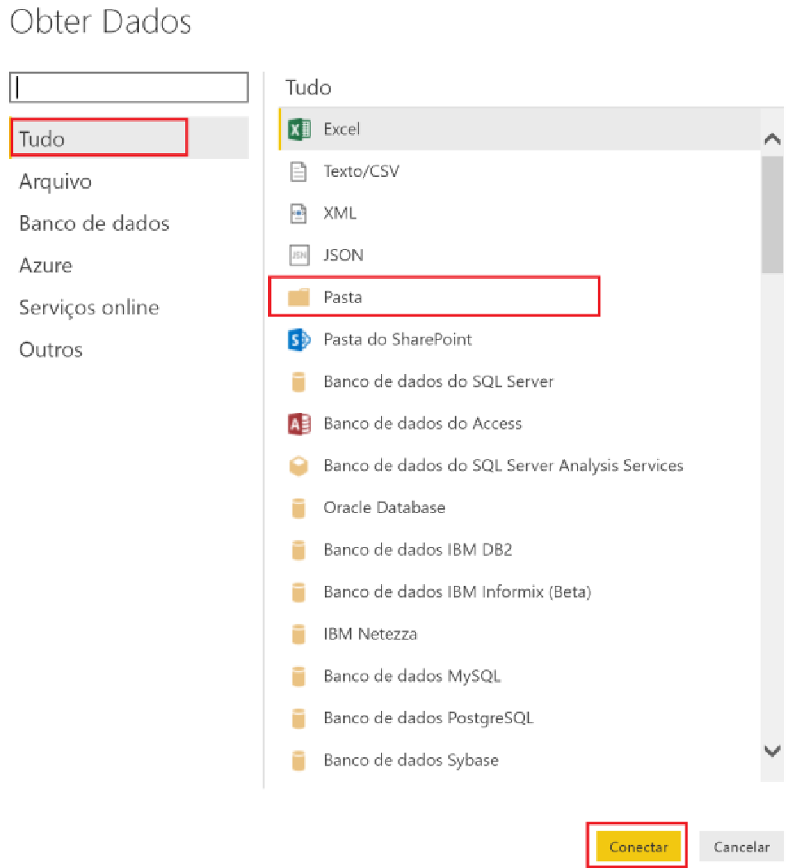
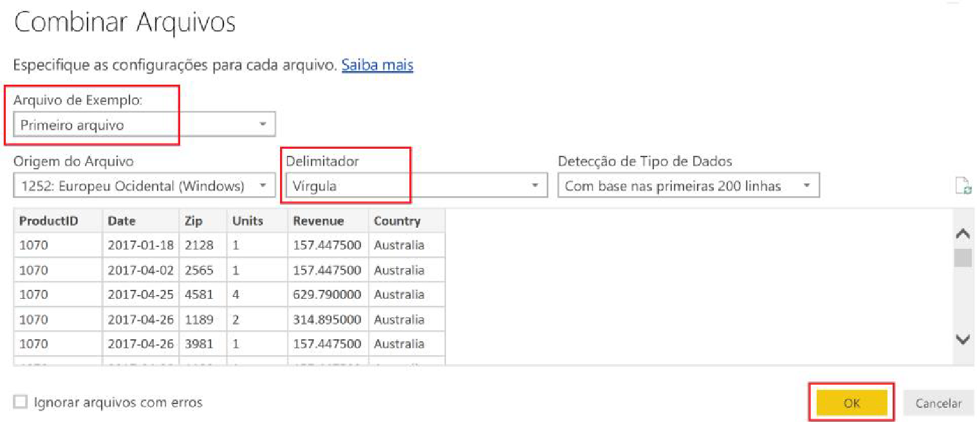
Combinar

Slide 11
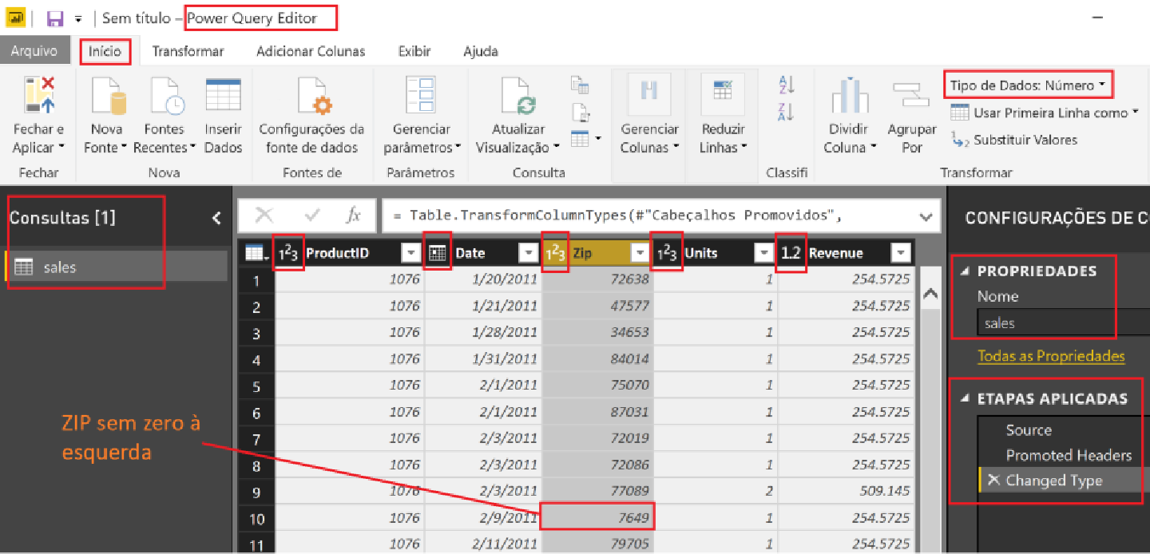
Limpar - Tipo de Dados

Slide 12
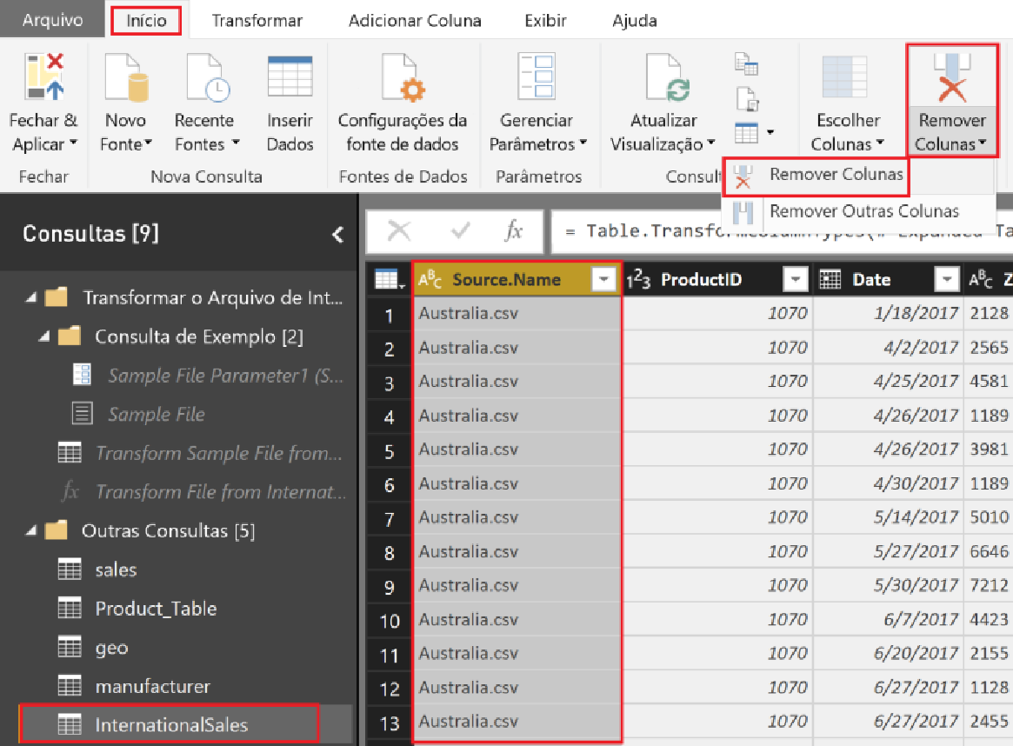
Remover Coluna

Slide 13
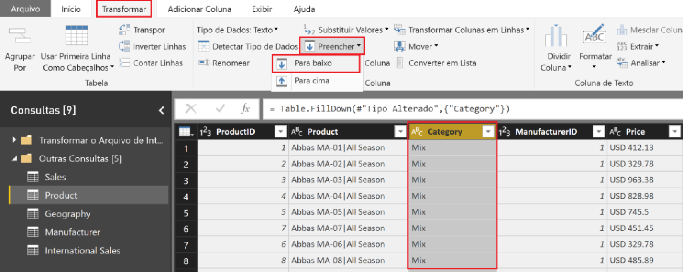
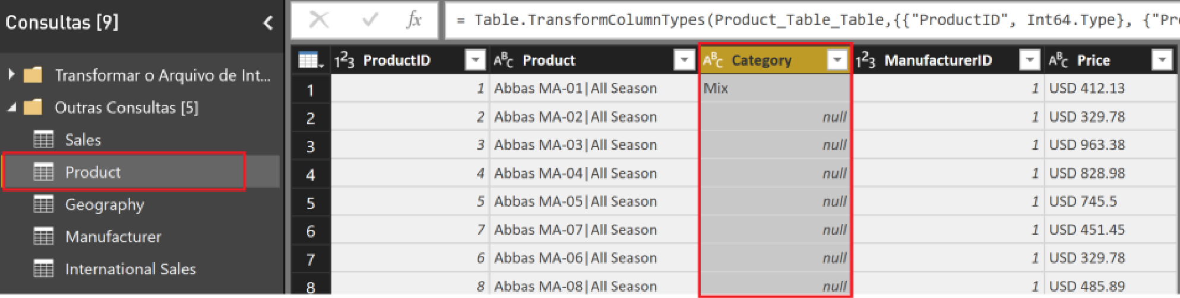
Preencher para Baixo

Slide 14
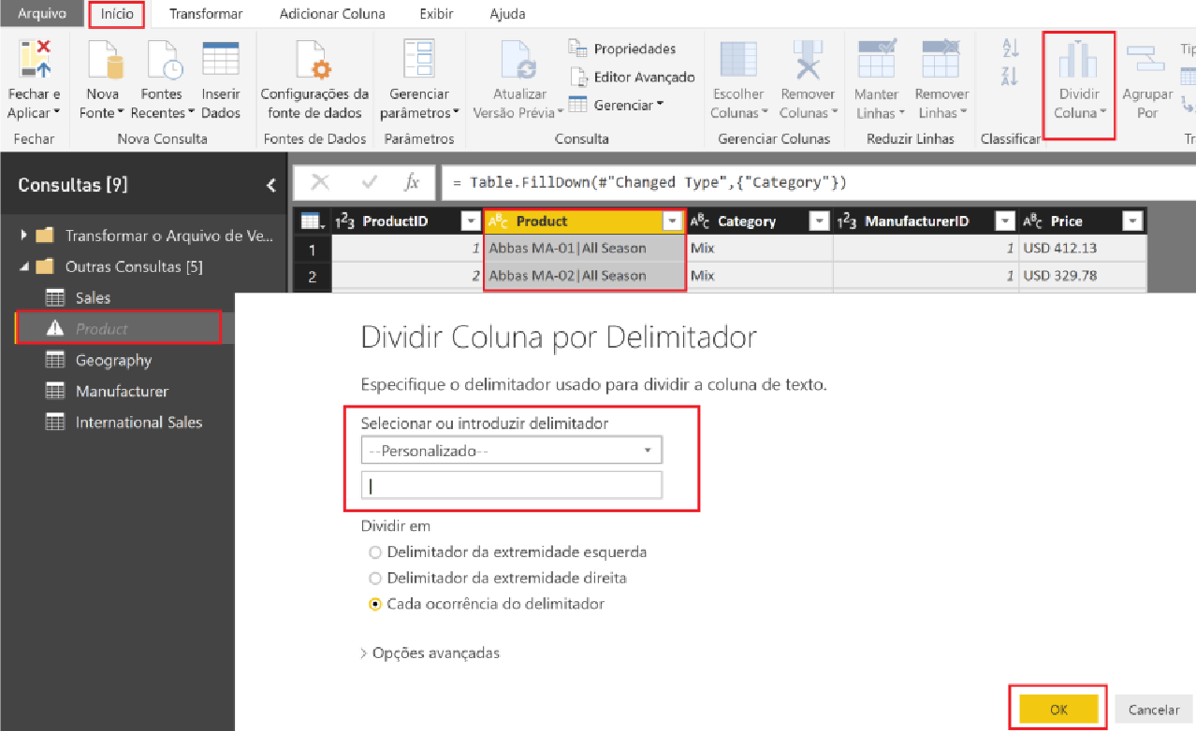
Dividir por Delimitador

Slide 15
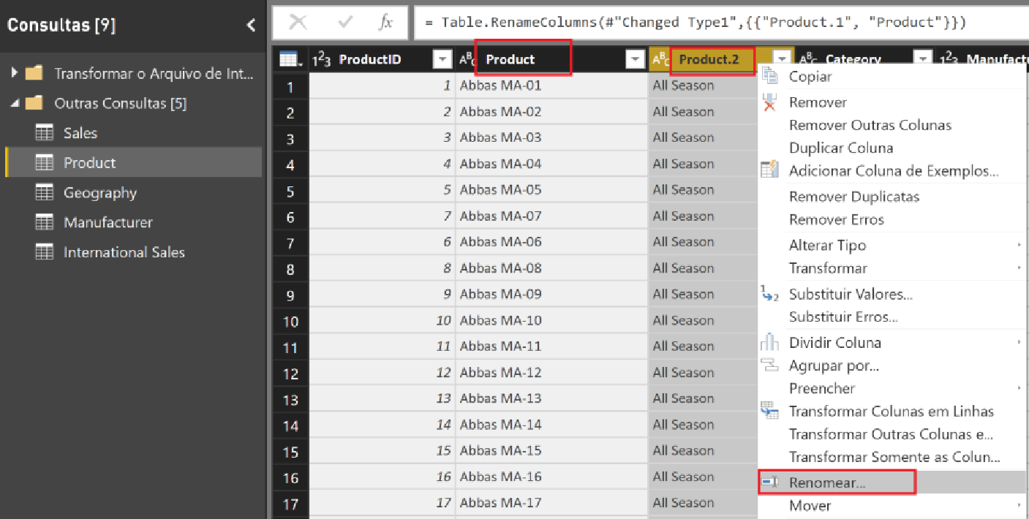
Renomear Coluna

Slide 16
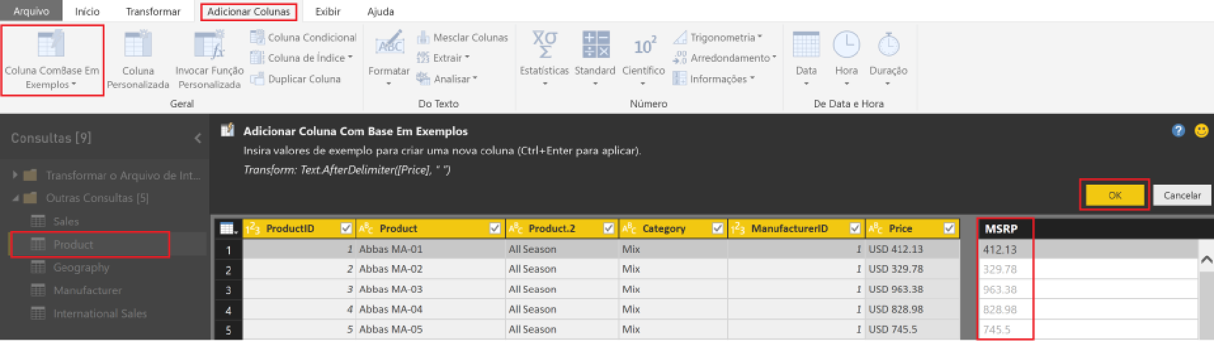
Adicionar Coluna Com Base Em Exemplos

Slide 17
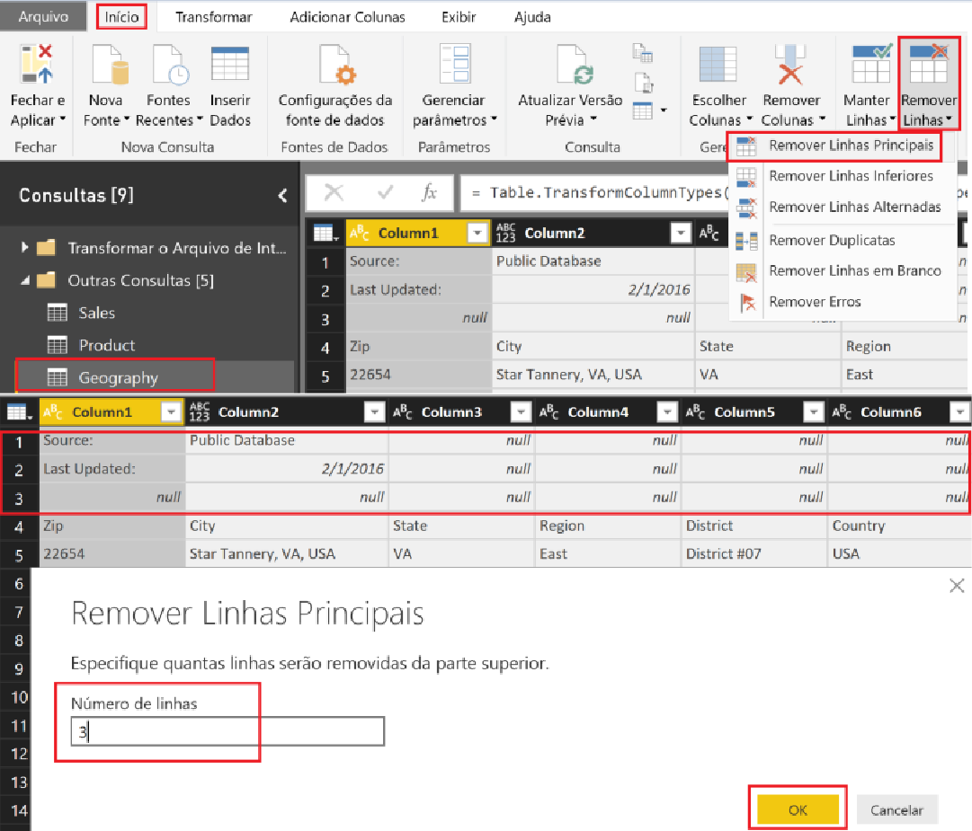
Remover Linhas

Slide 18
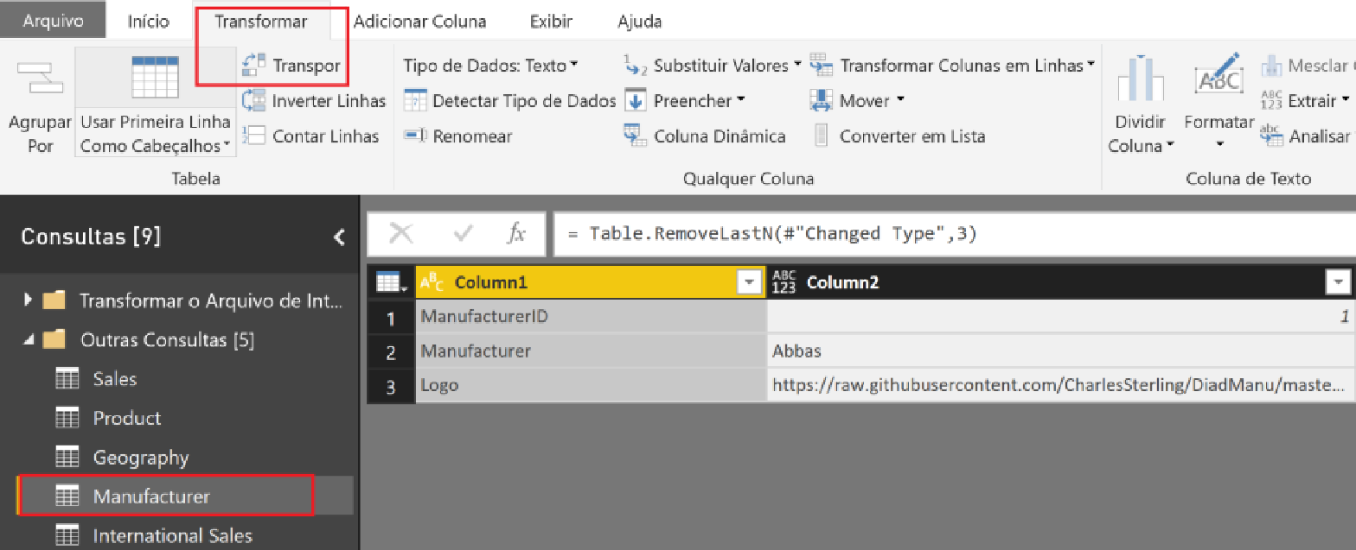
Transpor

Slide 19
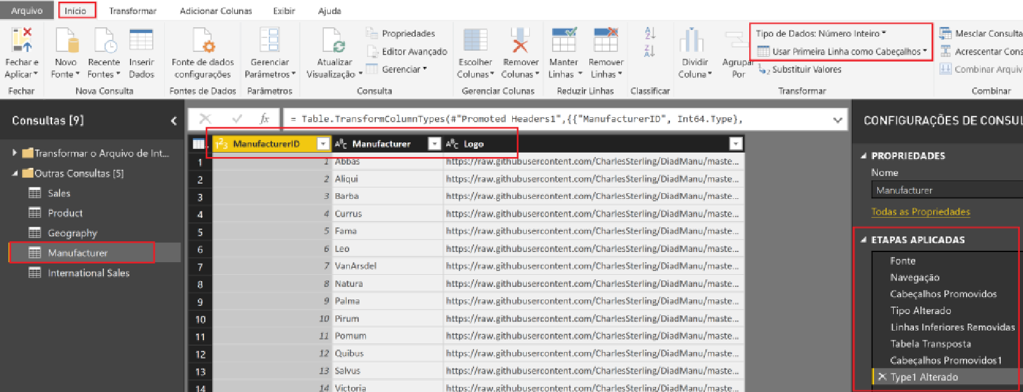
Usar Primeira Linha Como Cabeçalho

Slide 20
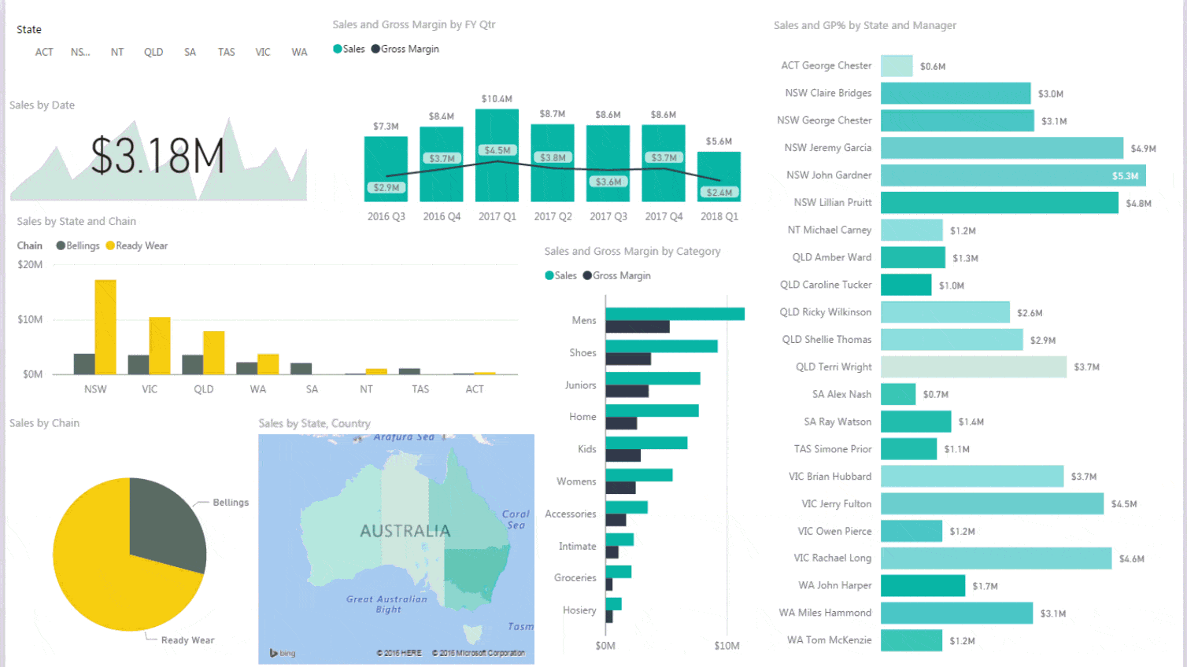
Interação entre gráficos

Slide 21
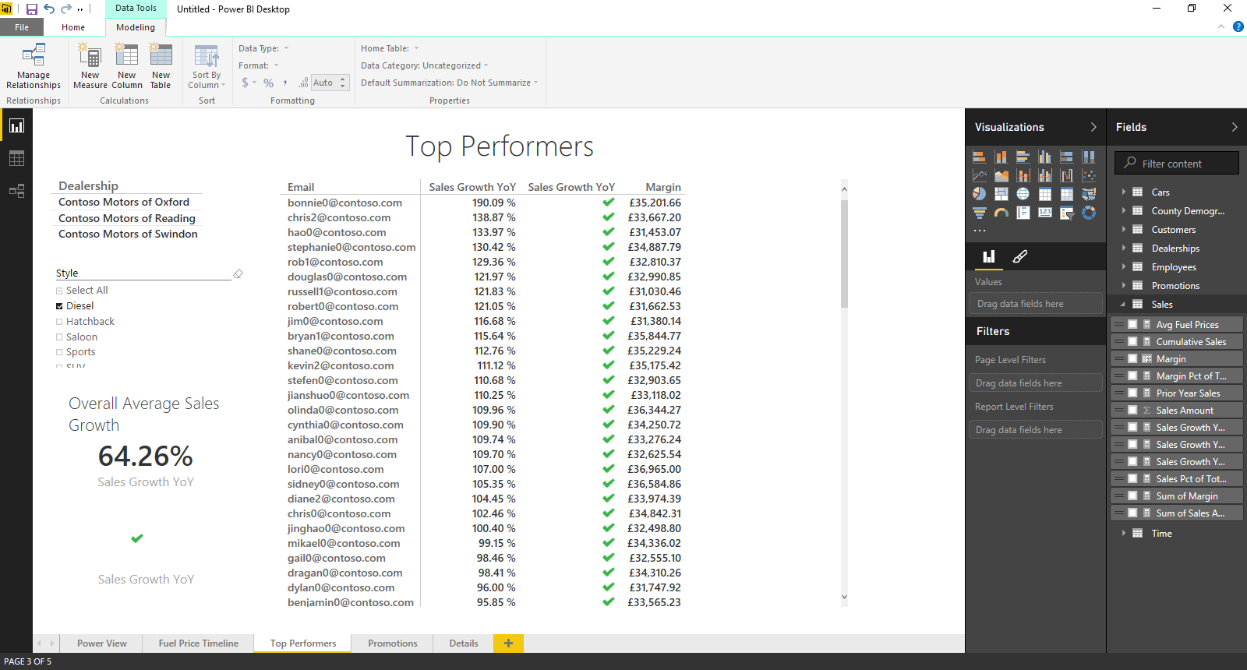
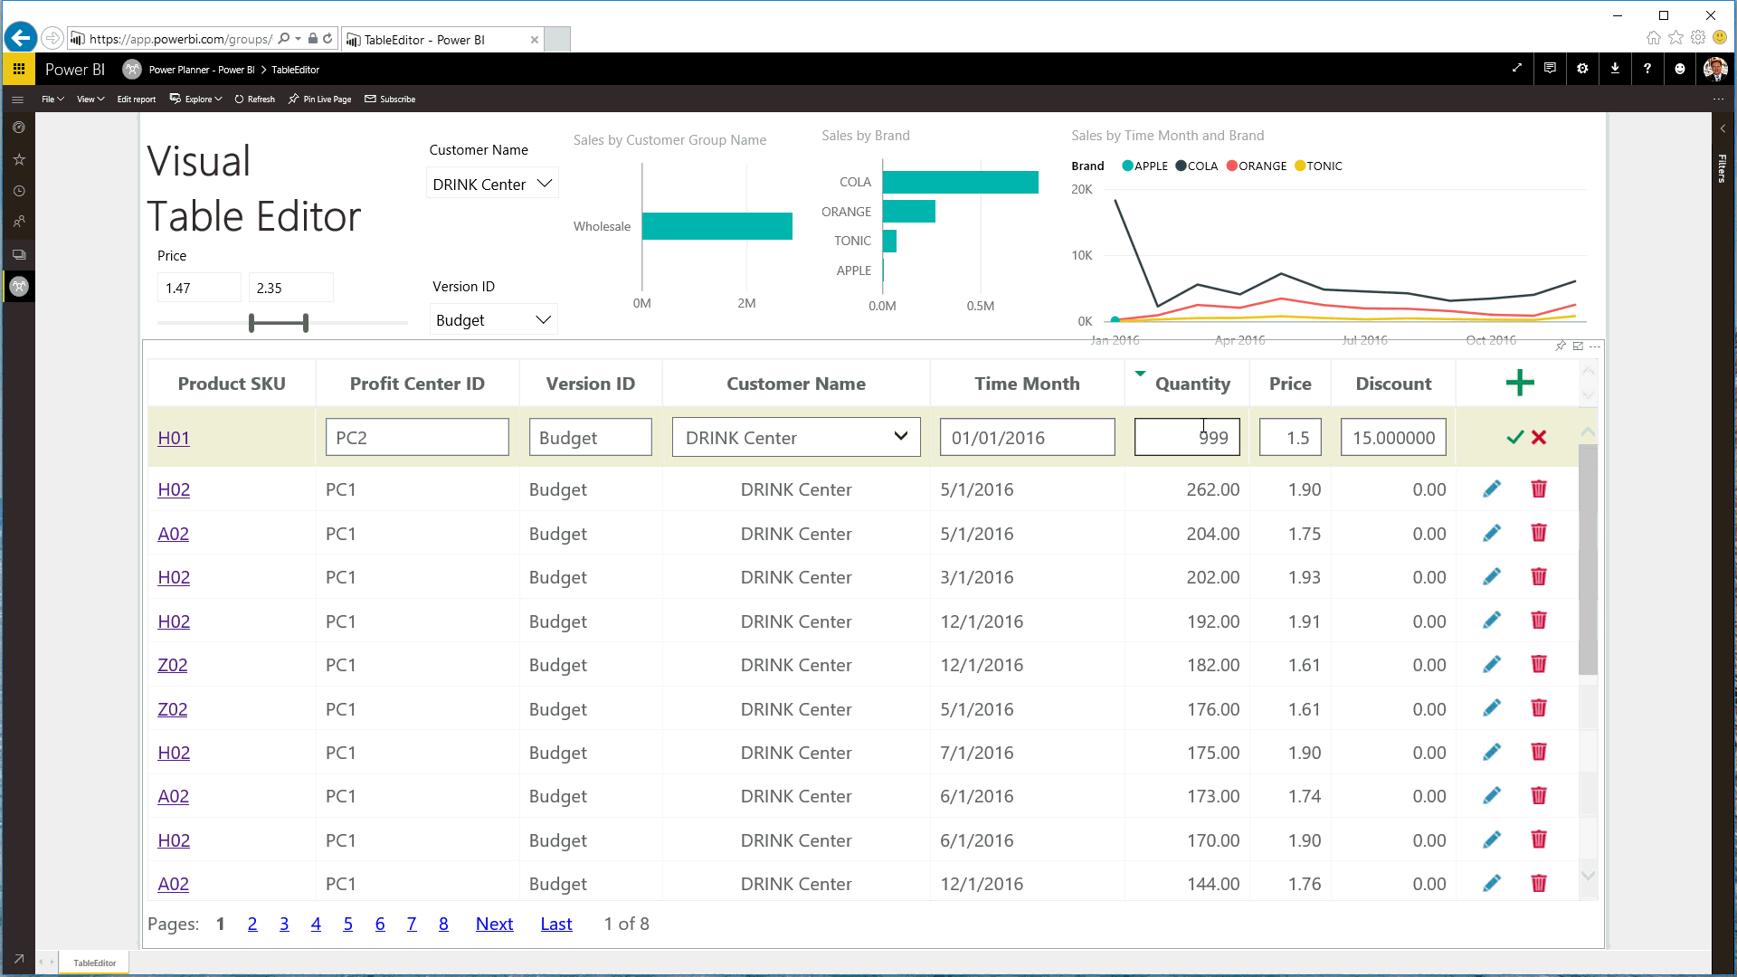
Tabelas

Slide 22
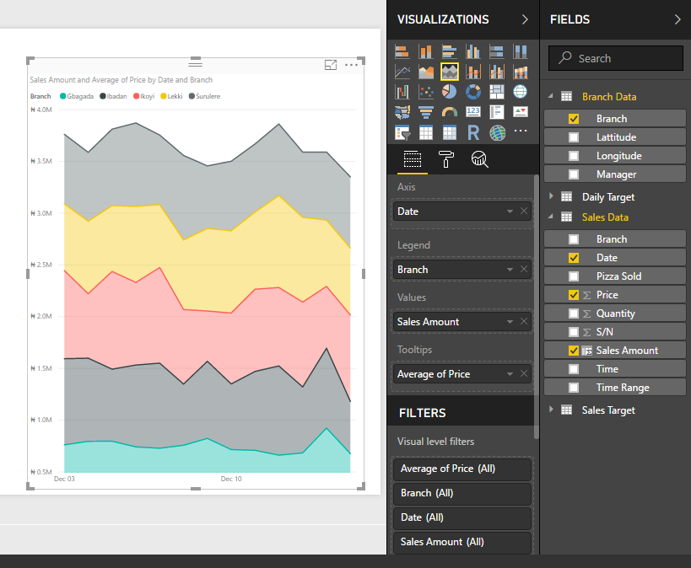
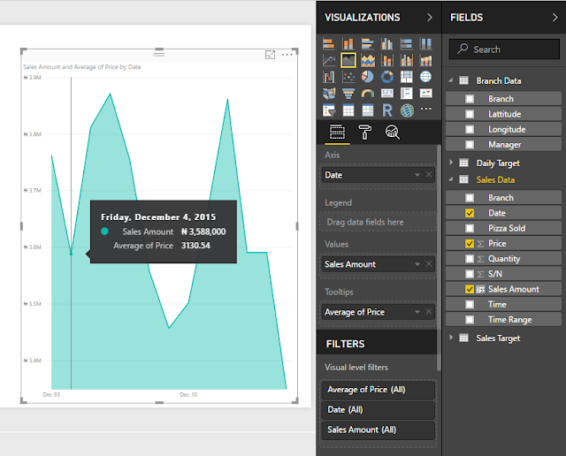
Gráfico de Área
Notes:
Key message:
Industry-leading SaaS service with large Power BI ecosystem (ISVs, SIs and partners creating unparalleled momentum)
Customers benefit from integration with other Microsoft products
There are several capabilities that differentiate Power BI from other offerings in the market.
Talking points:
Power BI is a cloud-based analytics service that provides faster time to insight. It is used for visualizing, exploring and extracting insights from data. It brings together data from diverse sources to deliver rich, comprehensive views of business operations.
What that means is, with Power BI, you can see all of your data through a single pane of glass, and create an analytics environment in minutes to monitor data and share reports. Live dashboards and reports show visualizations and KPIs from data that reside both on-premises and in the cloud, providing a consolidated view across your business regardless of where your data lives.
There are several capabilities that are unique to Power BI – these include:
Pre-built dashboards and reports for popular SaaS solutions such as Marketo, Salesforce, GitHub, ZenDesk, Dynamics CRM, and many others.
Dashboards and visualizations that support real-time updates.
Secure, live connection to on-premises data sources to drive insight across the entire range of organizational information (Analysis Services, Azure SQL Database, SQL Database Auditing, Azure SQL Data Warehouse).
Automated scheduled refresh to keep Power BI data in sync with on premises data sources.
Native mobile applications for keeping users connected on the go.
Easy integration with other Microsoft offerings, from Excel to Azure services.
Intuitive data exploration, which enables users to ask questions of their data in plain English.
The Power BI Service, sometimes referred to as powerbi.com, is what allows you to:
Create beautiful visualizations to tell compelling data stories.
Build rich, live dashboards that turn BI into business insights.
Create reports & datasets from which you can create visualizations and dashboards.
Enjoy the benefits of up-to-date data with real-time, automatic and scheduled refreshes.
Share dashboards easily with other people in your organization.
Ask questions of data in plain English with Natural Language Query.
Stay connected to data all the time with mobile applications.
To summarize, Power BI is a SaaS offering that enables anyone to easily connect to their data, create live operational dashboards and explore data via interactive visualizations.

Slide 23
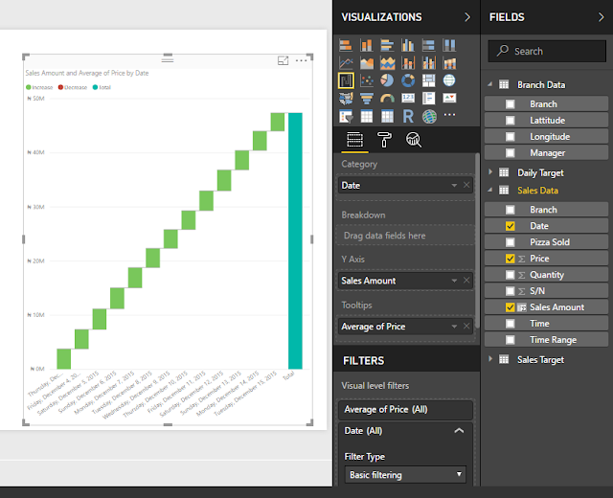
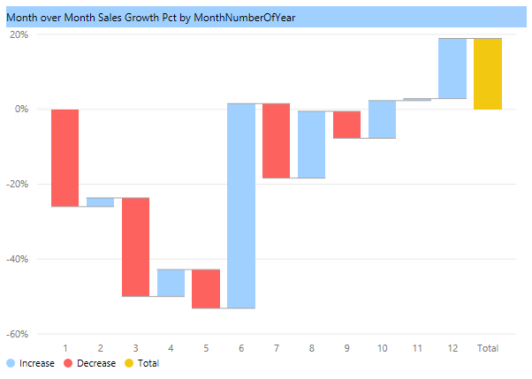
Waterfall

Slide 24
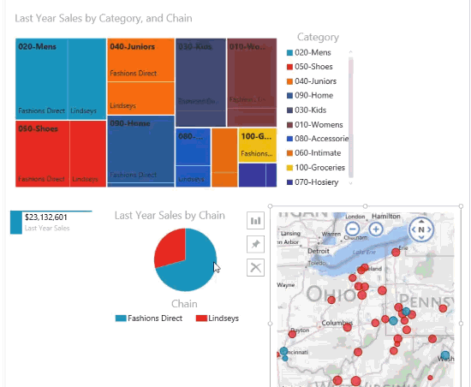
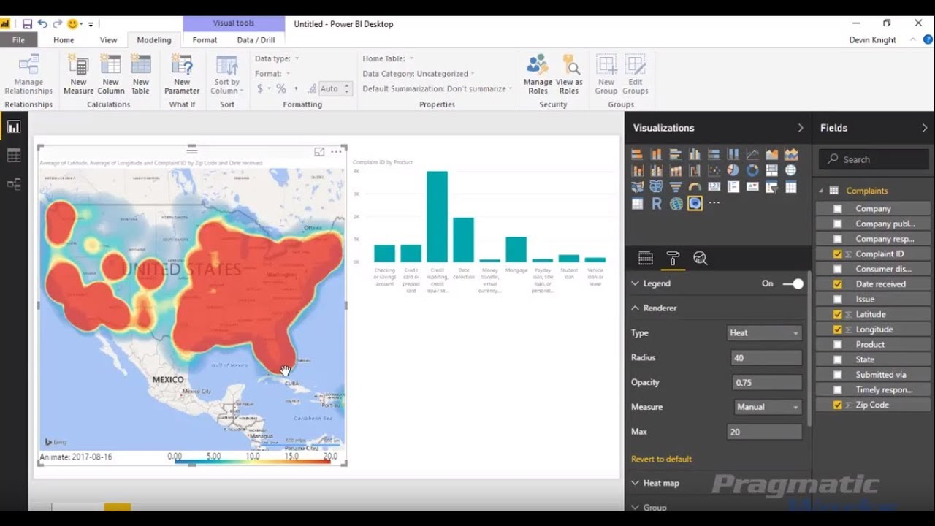
Geo Map, Tree Map, Pie Chart

Slide 25
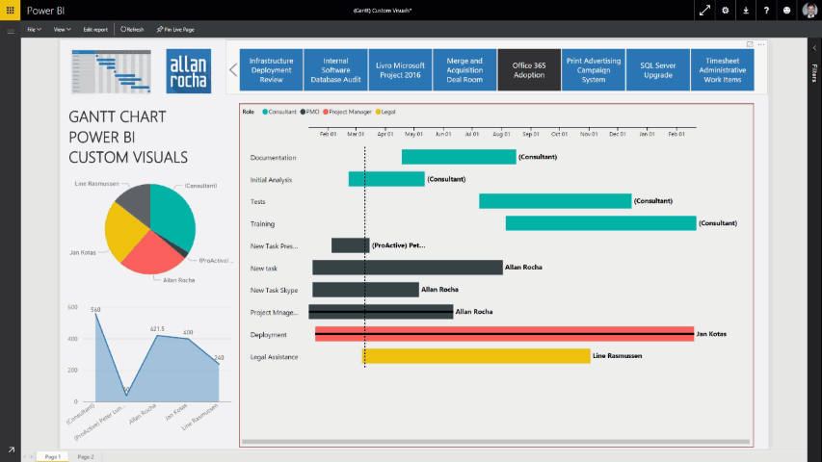
Gantt Chart

Slide 26
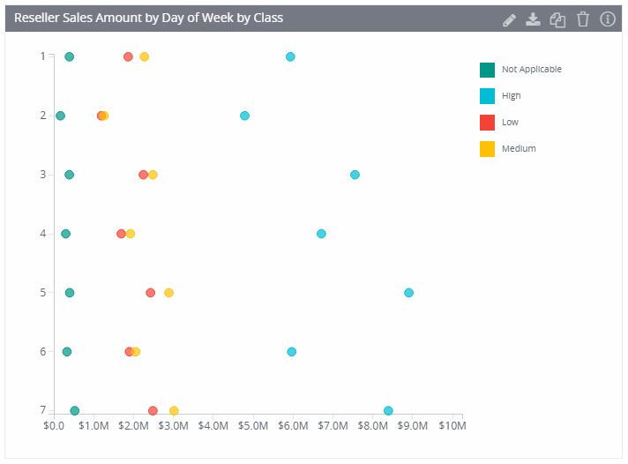
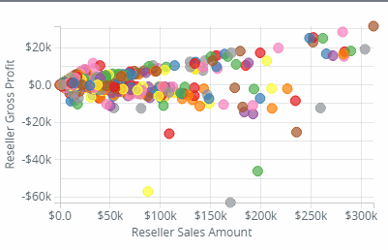
Dot Plot

Slide 27
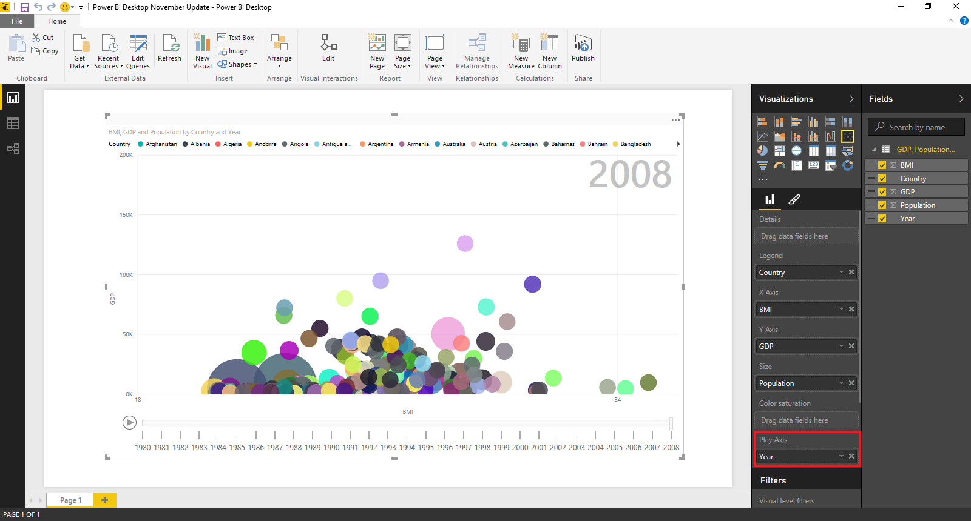
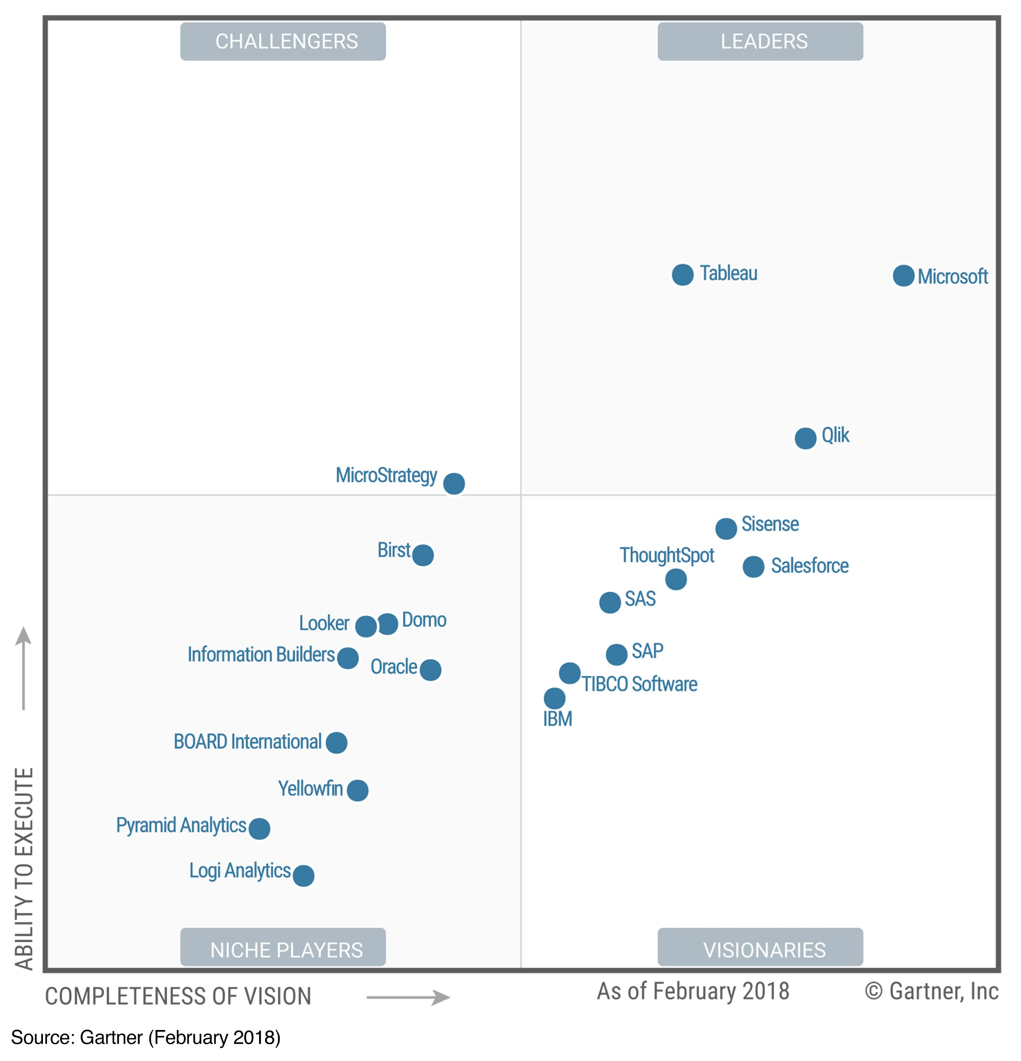
Scatter Plot
Notes:
Key message:
Industry-leading SaaS service with large Power BI ecosystem (ISVs, SIs and partners creating unparalleled momentum)
Customers benefit from integration with other Microsoft products
There are several capabilities that differentiate Power BI from other offerings in the market.
Talking points:
Power BI is a cloud-based analytics service that provides faster time to insight. It is used for visualizing, exploring and extracting insights from data. It brings together data from diverse sources to deliver rich, comprehensive views of business operations.
What that means is, with Power BI, you can see all of your data through a single pane of glass, and create an analytics environment in minutes to monitor data and share reports. Live dashboards and reports show visualizations and KPIs from data that reside both on-premises and in the cloud, providing a consolidated view across your business regardless of where your data lives.
There are several capabilities that are unique to Power BI – these include:
Pre-built dashboards and reports for popular SaaS solutions such as Marketo, Salesforce, GitHub, ZenDesk, Dynamics CRM, and many others.
Dashboards and visualizations that support real-time updates.
Secure, live connection to on-premises data sources to drive insight across the entire range of organizational information (Analysis Services, Azure SQL Database, SQL Database Auditing, Azure SQL Data Warehouse).
Automated scheduled refresh to keep Power BI data in sync with on premises data sources.
Native mobile applications for keeping users connected on the go.
Easy integration with other Microsoft offerings, from Excel to Azure services.
Intuitive data exploration, which enables users to ask questions of their data in plain English.
The Power BI Service, sometimes referred to as powerbi.com, is what allows you to:
Create beautiful visualizations to tell compelling data stories.
Build rich, live dashboards that turn BI into business insights.
Create reports & datasets from which you can create visualizations and dashboards.
Enjoy the benefits of up-to-date data with real-time, automatic and scheduled refreshes.
Share dashboards easily with other people in your organization.
Ask questions of data in plain English with Natural Language Query.
Stay connected to data all the time with mobile applications.
To summarize, Power BI is a SaaS offering that enables anyone to easily connect to their data, create live operational dashboards and explore data via interactive visualizations.

Slide 28
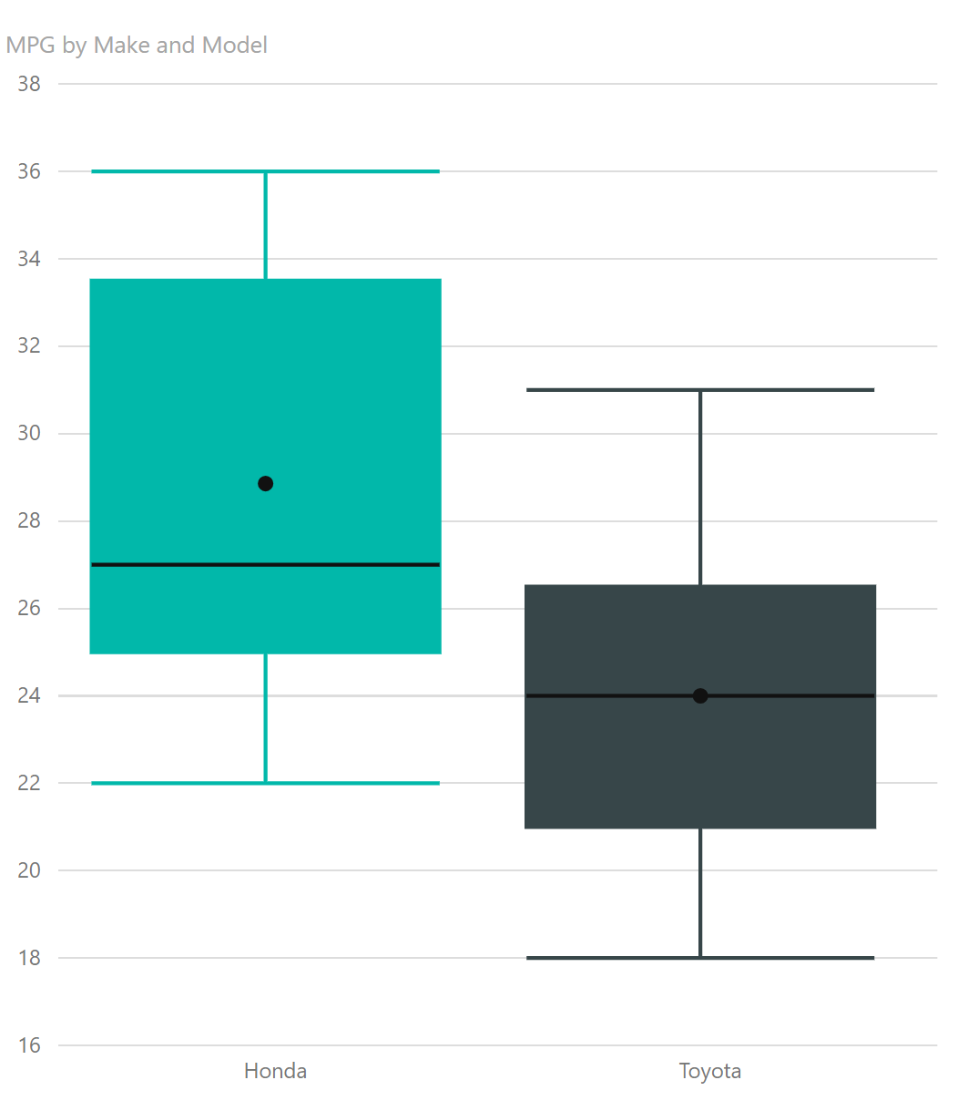

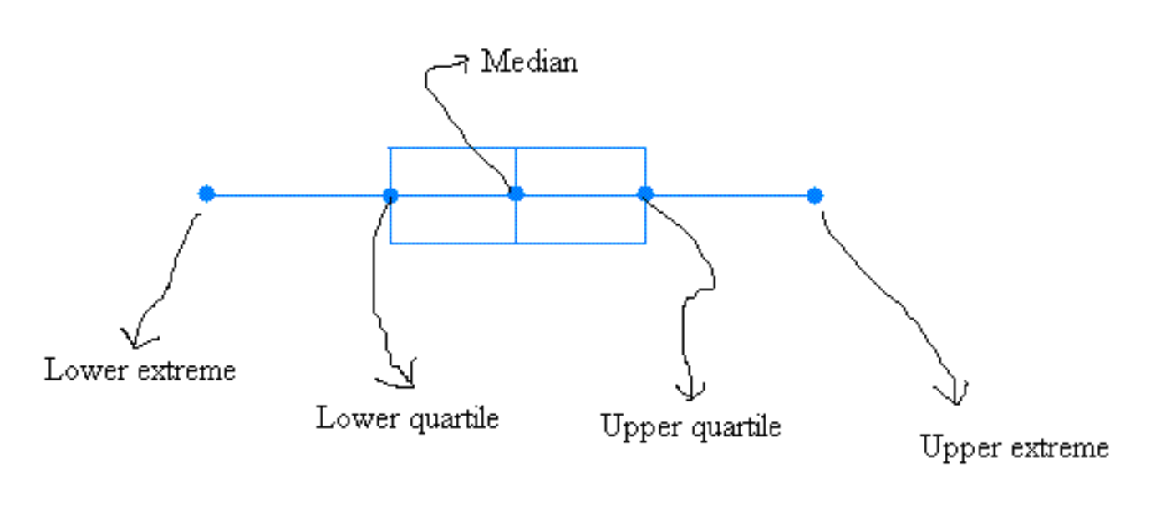
Box Plot and Whisker Chart
MPG = Miles per gallon
https://devinknightsql.com/2017/01/24/power-bi-custom-visuals-class-module-35-box-and-whiskers-jan-pieter/
Notes:
O centro da distribuição é indicado pela linha da mediana, no centro do quadrado.
A dispersão é representada pela amplitude do gráfico, que pode ser calculada como máximo valor – mínimo valor. Quanto maior for a amplitude, maior a variação nos dados.
O retângulo contém 50% dos valores do conjunto de dados.
O whisker sao as extremidades.

Slide 29
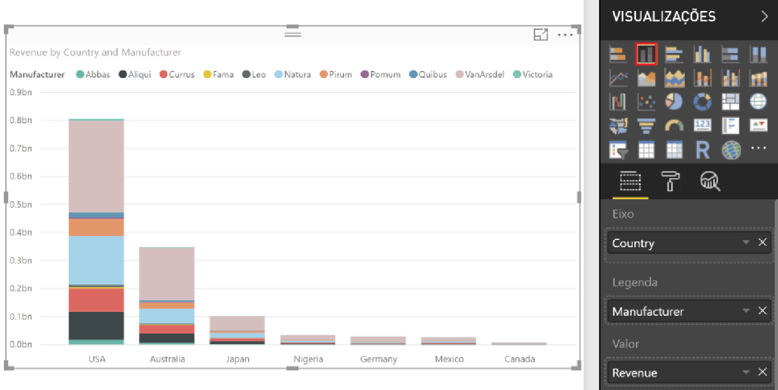
Vamos praticar?
Adicione gráfico com valor de Vendas por Fabricante.
Verifique o relacionamento entre a consulta de Geografia (Geography) e Vendas (sales).

Slide 30
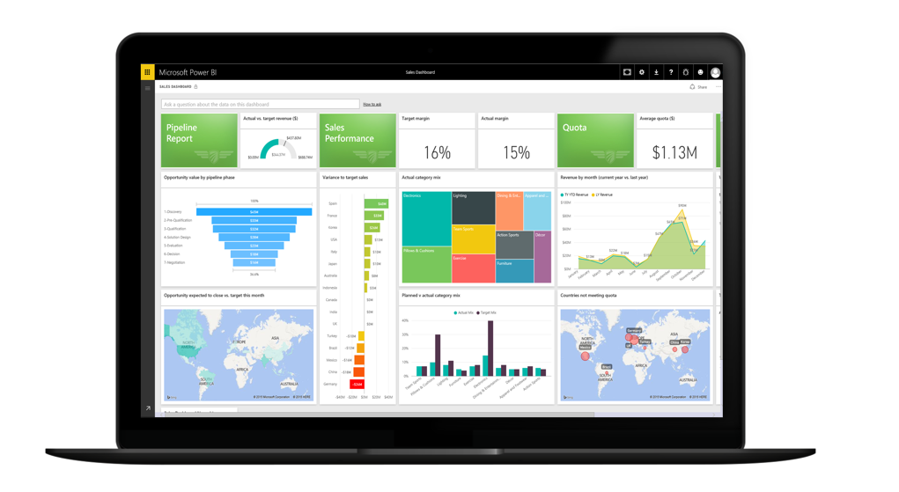
Visualizar
Notes:
Key message:
Industry-leading SaaS service with large Power BI ecosystem (ISVs, SIs and partners creating unparalleled momentum)
Customers benefit from integration with other Microsoft products
There are several capabilities that differentiate Power BI from other offerings in the market.
Talking points:
Power BI is a cloud-based analytics service that provides faster time to insight. It is used for visualizing, exploring and extracting insights from data. It brings together data from diverse sources to deliver rich, comprehensive views of business operations.
What that means is, with Power BI, you can see all of your data through a single pane of glass, and create an analytics environment in minutes to monitor data and share reports. Live dashboards and reports show visualizations and KPIs from data that reside both on-premises and in the cloud, providing a consolidated view across your business regardless of where your data lives.
There are several capabilities that are unique to Power BI – these include:
Pre-built dashboards and reports for popular SaaS solutions such as Marketo, Salesforce, GitHub, ZenDesk, Dynamics CRM, and many others.
Dashboards and visualizations that support real-time updates.
Secure, live connection to on-premises data sources to drive insight across the entire range of organizational information (Analysis Services, Azure SQL Database, SQL Database Auditing, Azure SQL Data Warehouse).
Automated scheduled refresh to keep Power BI data in sync with on premises data sources.
Native mobile applications for keeping users connected on the go.
Easy integration with other Microsoft offerings, from Excel to Azure services.
Intuitive data exploration, which enables users to ask questions of their data in plain English.
The Power BI Service, sometimes referred to as powerbi.com, is what allows you to:
Create beautiful visualizations to tell compelling data stories.
Build rich, live dashboards that turn BI into business insights.
Create reports & datasets from which you can create visualizations and dashboards.
Enjoy the benefits of up-to-date data with real-time, automatic and scheduled refreshes.
Share dashboards easily with other people in your organization.
Ask questions of data in plain English with Natural Language Query.
Stay connected to data all the time with mobile applications.
To summarize, Power BI is a SaaS offering that enables anyone to easily connect to their data, create live operational dashboards and explore data via interactive visualizations.

Slide 31
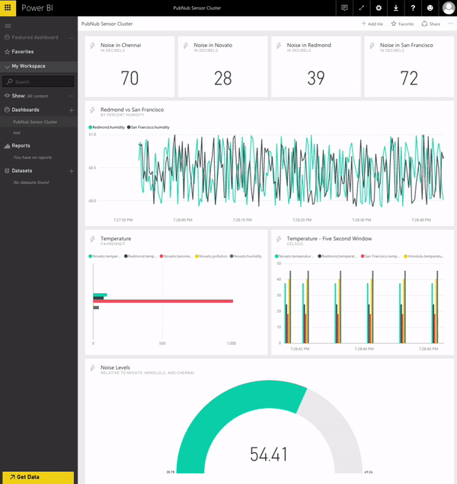
Real Time Dashboards

Slide 32
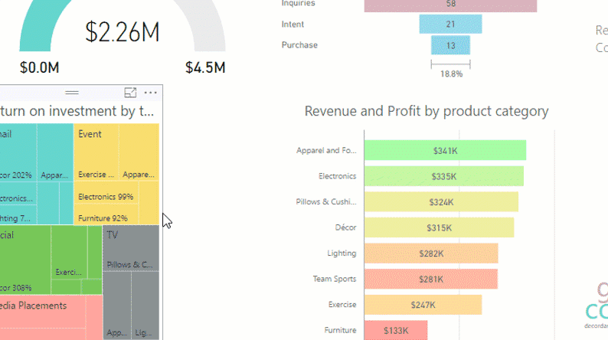
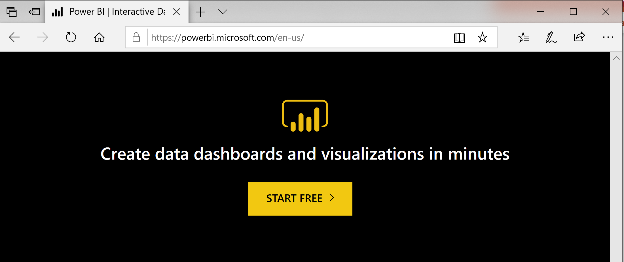
Compartilhar
https://powerbi.microsoft.com
Notes:
Key message:
Industry-leading SaaS service with large Power BI ecosystem (ISVs, SIs and partners creating unparalleled momentum)
Customers benefit from integration with other Microsoft products
There are several capabilities that differentiate Power BI from other offerings in the market.
Talking points:
Power BI is a cloud-based analytics service that provides faster time to insight. It is used for visualizing, exploring and extracting insights from data. It brings together data from diverse sources to deliver rich, comprehensive views of business operations.
What that means is, with Power BI, you can see all of your data through a single pane of glass, and create an analytics environment in minutes to monitor data and share reports. Live dashboards and reports show visualizations and KPIs from data that reside both on-premises and in the cloud, providing a consolidated view across your business regardless of where your data lives.
There are several capabilities that are unique to Power BI – these include:
Pre-built dashboards and reports for popular SaaS solutions such as Marketo, Salesforce, GitHub, ZenDesk, Dynamics CRM, and many others.
Dashboards and visualizations that support real-time updates.
Secure, live connection to on-premises data sources to drive insight across the entire range of organizational information (Analysis Services, Azure SQL Database, SQL Database Auditing, Azure SQL Data Warehouse).
Automated scheduled refresh to keep Power BI data in sync with on premises data sources.
Native mobile applications for keeping users connected on the go.
Easy integration with other Microsoft offerings, from Excel to Azure services.
Intuitive data exploration, which enables users to ask questions of their data in plain English.
The Power BI Service, sometimes referred to as powerbi.com, is what allows you to:
Create beautiful visualizations to tell compelling data stories.
Build rich, live dashboards that turn BI into business insights.
Create reports & datasets from which you can create visualizations and dashboards.
Enjoy the benefits of up-to-date data with real-time, automatic and scheduled refreshes.
Share dashboards easily with other people in your organization.
Ask questions of data in plain English with Natural Language Query.
Stay connected to data all the time with mobile applications.
To summarize, Power BI is a SaaS offering that enables anyone to easily connect to their data, create live operational dashboards and explore data via interactive visualizations.

Slide 33
P&R

Slide 34

Material para Estudar:
https://docs.microsoft.com/pt-br/power-bi/desktop-getting-started

Slide 35
Deixe seu feedback!
http://bit.ly/bootcamp-ds-sp-feedback-19

Slide 36

You’ve got the POWER BI…
camila.ribeiro@microsoft.com
https://www.linkedin.com/in/camilamacena/

